Slide 1
Intro to Dataset and what it contains
This dataset contains medical insurance cost information for 1338 individuals. It includes demographic and health-related variables such as age, sex, BMI, number of children, smoking status, and residential region in the US. The target variable is charges, which represents the medical insurance cost billed to the individual.
Age: Age of primary beneficiary (int)
Sex: Gender of beneficiary (male, female)
Bmi: Body Mass Index, a measure of body fat based on height and weight (float)
Children: Number of children covered by health insurance (int)
Smoker: Smoking status of the beneficiary (yes, no)
Region: Residential region in the US (northeast, northwest, southeast, southwest)
Charges: Medical insurance cost billed to the beneficiary (float)
Features Created:-
Age Group: Teens, Young adults, Uncs, Middle aged, Seniors
Child: Has Child, No child
BMI category: Underweight, Normal Weight, Overweight, Obese

Slide 2
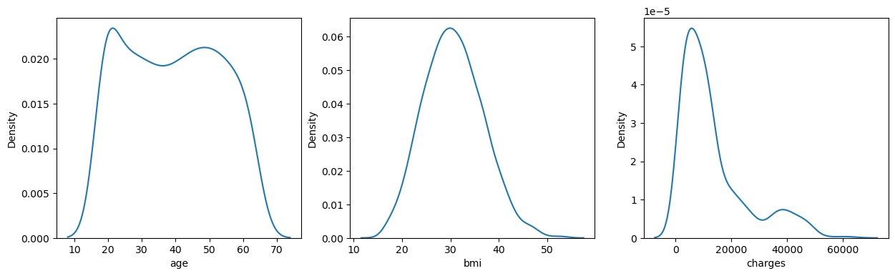
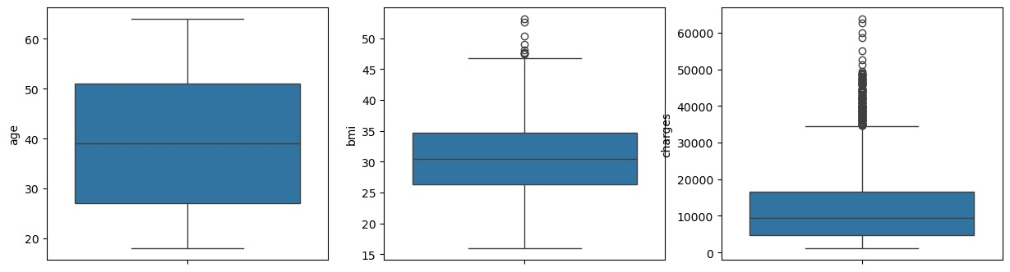
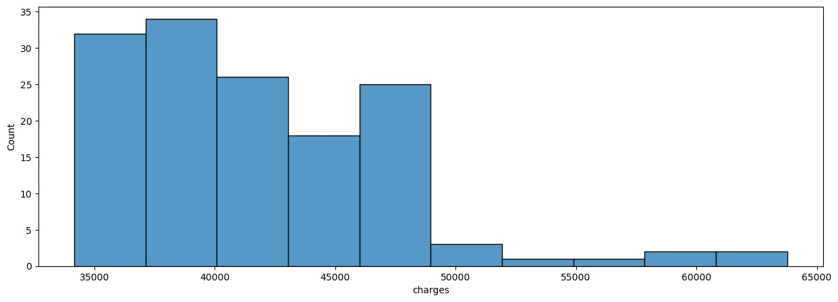
1) Distribution of Age, BMI and Charges
BMI looks fairly normally distributed, with few outliers while charges is highly right skewed, with very large number of outliers.
The distribution of charge outliers can also be seen, which is mostly in the range of 35000-50000.

Slide 3
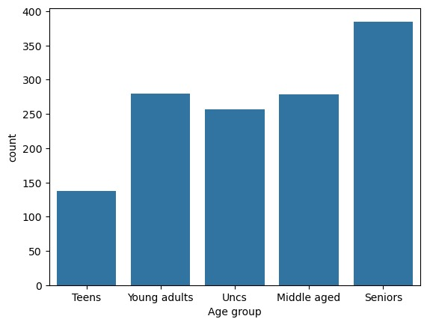
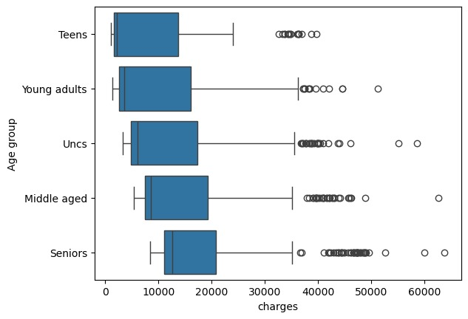
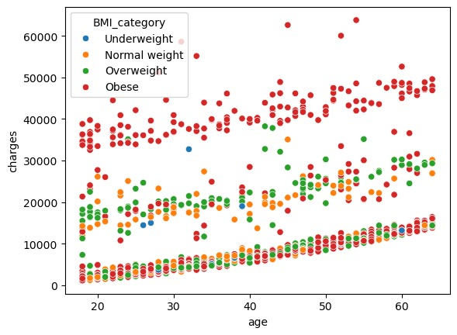
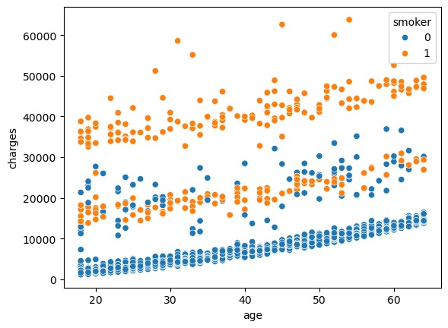
Age EDA
The bins for Age distribution was:-
(18-19) Teens, 20-29 (Young Adults) , 30-39 (Uncs) , 40-49 (Middle Aged), 50-64 (Seniors)
2nd fig. Charge outliers in teens is approximately >25000, while for the rest of the categories it is roughly >36000. Notice that minimum cost is gradually increasing with age.
The 3rd and 4th plot shows a gradual increase of charges with the increase in age. The hues of BMI_category and smoker status adds to the information that charges are higher for people with high BMI and people who smoke for the same age.

Slide 4
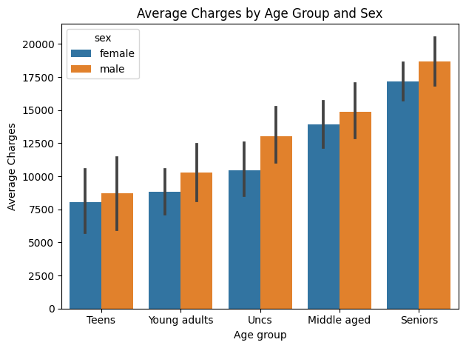
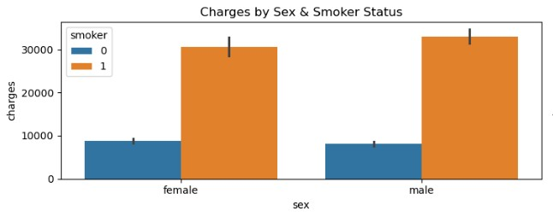
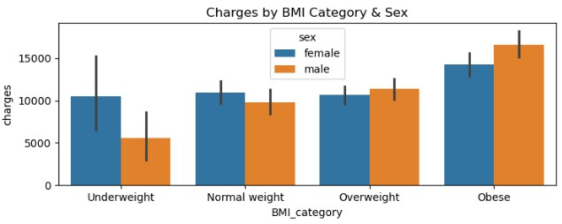
Sex EDA
1st barplot is yet another proof that charges increase with age, and also tells us that average charges are higher for males in all age groups.
Charges increase (and it is a drastic difference) if you are a smoker, for both males and females.
Majority of people are either overweight or obese

Slide 5
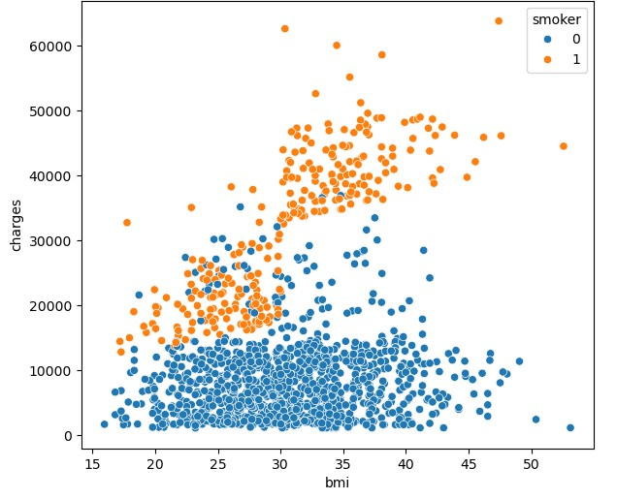
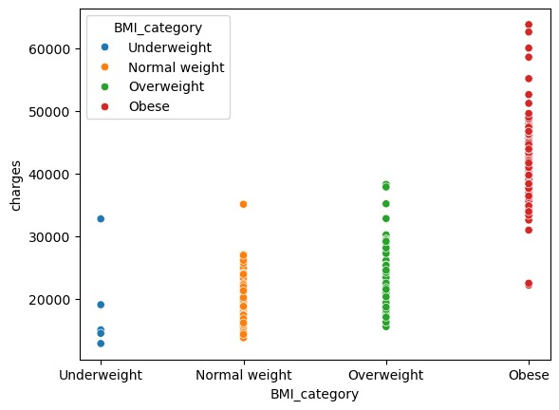
BMI EDA
The two plots clearly show how charges are higher for people with higher BMI. The 1st scatterplot also shows that smoking highly affects the charges.

Slide 6
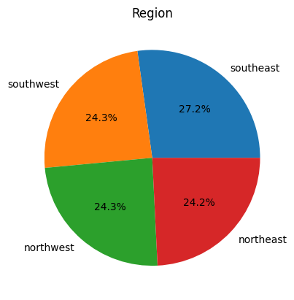
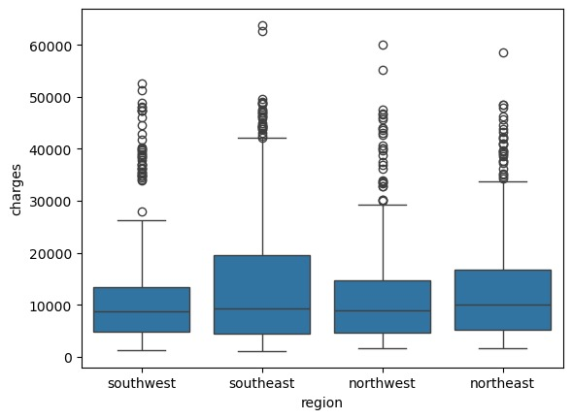
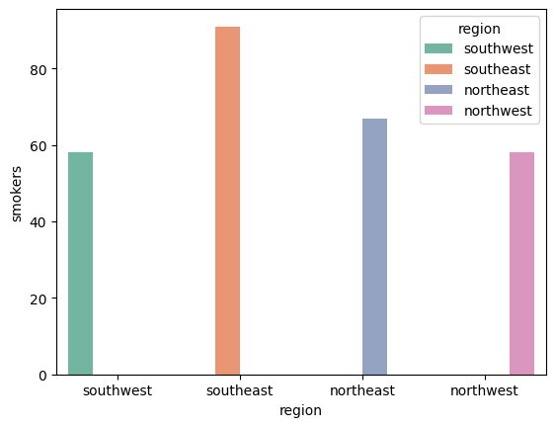
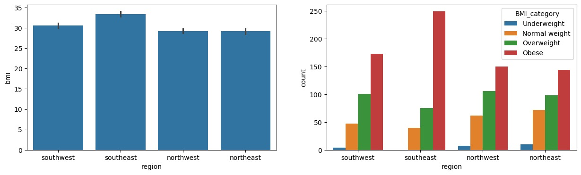
Region and Smoker EDA
The distribution of people across all 4 regions is almost balanced, each a quarter.
The Southeast region has highest number of smokers, and people over there also have on average, a higher BMI.
The charges are also higher for people of southeast

Slide 7
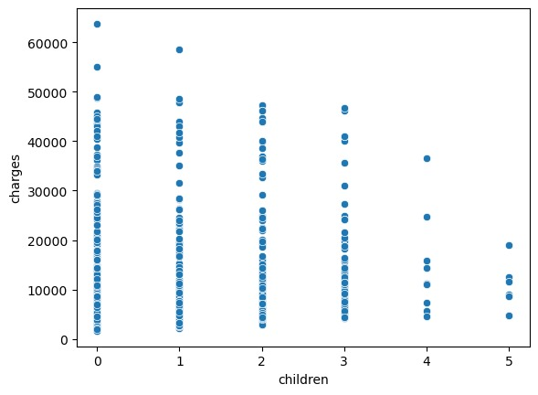
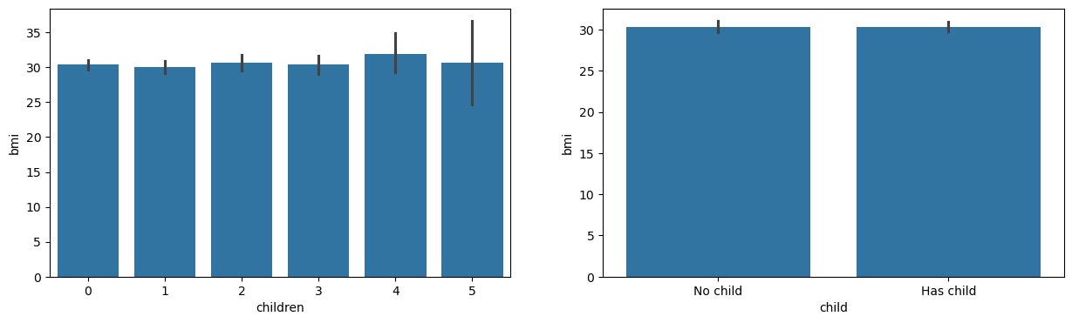
Hypothesis testing
1) Do charges for females increase with number of children?
2) Does BMI increase for females with number of children?
OLS Regression Results
==============================================================================
Dep. Variable: bmi R-squared: 0.000
Model: OLS Adj. R-squared: -0.001
Method: Least Squares F-statistic: 0.3240
Date: Fri, 24 Oct 2025 Prob (F-statistic): 0.569
Time: 10:36:08 Log-Likelihood: -2129.9
No. Observations: 662 AIC: 4264.
Df Residuals: 660 BIC: 4273.
Df Model: 1
Covariance Type: nonrobust
==============================================================================
coef std err t P>|t| [0.025 0.975]
------------------------------------------------------------------------------
const 30.2571 0.317 95.582 0.000 29.636 30.879
children 0.1123 0.197 0.569 0.569 -0.275 0.500
==============================================================================
Omnibus: 8.587 Durbin-Watson: 1.841
Prob(Omnibus): 0.014 Jarque-Bera (JB): 8.379
Skew: 0.243 Prob(JB): 0.0152
Kurtosis: 2.739 Cond. No. 2.62
==============================================================================
Notes:
[1] Standard Errors assume that the covariance matrix of the errors is correctly specified.
OLS Regression Results
==============================================================================
Dep. Variable: charges R-squared: 0.003
Model: OLS Adj. R-squared: 0.002
Method: Least Squares F-statistic: 2.266
Date: Fri, 24 Oct 2025 Prob (F-statistic): 0.133
Time: 10:36:09 Log-Likelihood: -7105.7
No. Observations: 662 AIC: 1.422e+04
Df Residuals: 660 BIC: 1.422e+04
Df Model: 1
Covariance Type: nonrobust
==============================================================================
coef std err t P>|t| [0.025 0.975]
------------------------------------------------------------------------------
const 1.198e+04 581.820 20.596 0.000 1.08e+04 1.31e+04
children 546.0350 362.752 1.505 0.133 -166.252 1258.323
==============================================================================
Omnibus: 221.266 Durbin-Watson: 1.992
Prob(Omnibus): 0.000 Jarque-Bera (JB): 553.848
Skew: 1.751 Prob(JB): 5.41e-121
Kurtosis: 5.797 Cond. No. 2.62
==============================================================================
Notes:
[1] Standard Errors assume that the covariance matrix of the errors is correctly specified.
P value of 0.569 shows that BMI is unaffected by number of children and is highly insignificant to BMI
Hence, the answer is No, higher number of children dont cause high BMI in females
P value of 0.1 proves that it is insignificant

Slide 8
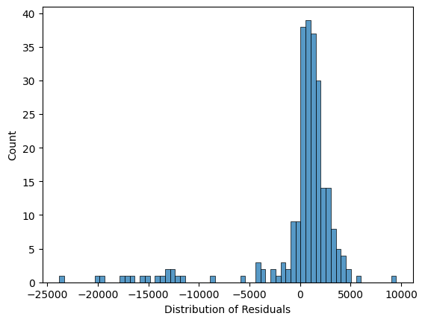
Building a model
The model chosen for predicting the insurance charges was RandomForestRegressor. Another good choice would have been XGBoost, but it gave a similar r2_score.
LinearRegression would have been a bad choice because the relationship between features and target was not linear.
The model was first trained on all features, and after using the feature_importances_ attribute, only the main features were selected for the final model
The model was then manually hyperparameter tuned on important hyperparameters like n_estimators,criterion,max_depth,min_samples_split,min_samples_leaf,max_features on the validation dataset
After that, it was used to predict on test samples, on which the model got a r2_score of 88.23% and Root Mean Squared Error of 4561.91

Slide 9
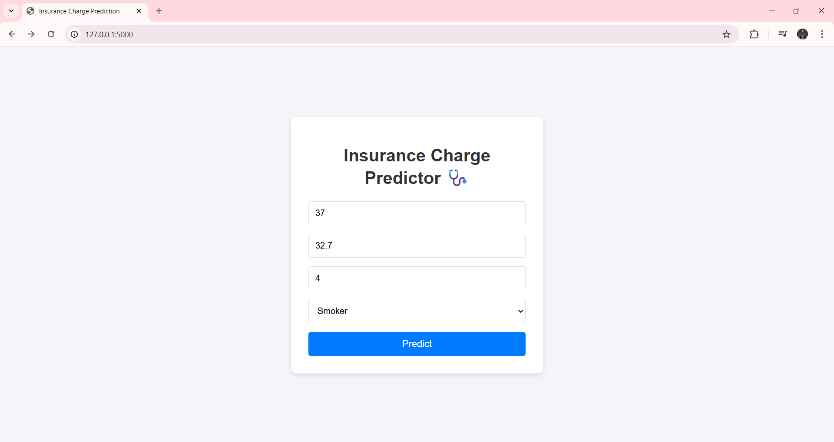
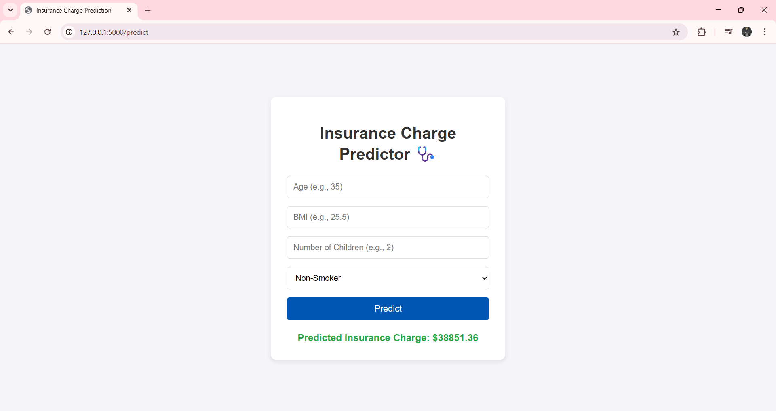
Model Deployment
The model was then deployed on a localhost page, whose pictures you can see above
Limitation:-
While the model has a strong r2_score of 88.23%, it is based on a limited dataset of 1,338 individuals. Therefore, it should be used to predict general charge estimates, rather than exact charge estimates.

